Slide 1



Once for All: Train One Network and Specialize
it for Efficient Deployment
Han Cai, Chuang Gan, Tianzhe Wang, Zhekai Zhang, Song Han
Massachusetts Institute of Technology, MIT-IBM Watson AI Lab
分享人：李兆星

Slide 2
纲要
1.背景介绍
论文方向简介
作者简介
会议简介
2.论文动机
3.主要方法
4.实验结果
5.总结
6.思考

Slide 3
论文方向简介
1. Efficient Deep Learning
many efficient deep learning architectures are proposed to improve the hardware efficiency, such as SqueezeNet, MobileNets, ShuffleNets, etc
model compression, network pruning that removes redundant units or redundant channels, and quantization that reduces the bit width
2. Neural Architecture Search
NAS focuses on automating the architecture design process.
early NAS methods(NASNet, AmoebaNet) search for high accuracy architectures without taking hardware efficiency into consideration.
recent hardware-aware NAS methods(Hardware-DNN co-design techniques)directly incorporate the hardware feedback into architecture search

Slide 4

作者简介
韩松，个人主页https://songhan.mit.edu
Assistant professor in MIT's Department of Electrical Engineering and Computer Science
research focuses on efficient deep learning computing
MIT HAN Lab
H: High performance, High energy efficiency Hardware
A: AutoML, Architectures and Accelerators for AI
N: Novel applications with Neural Networks
Awards
Deep Compression: Compressing Deep Neural Networks with Pruning, Trained Quantization and Huffman Coding, Best paper award, ICLR’2016
ESE: Efficient Speech Recognition Engine with Sparse LSTM on FPGA, Best paper award, FPGA’2017

Slide 5
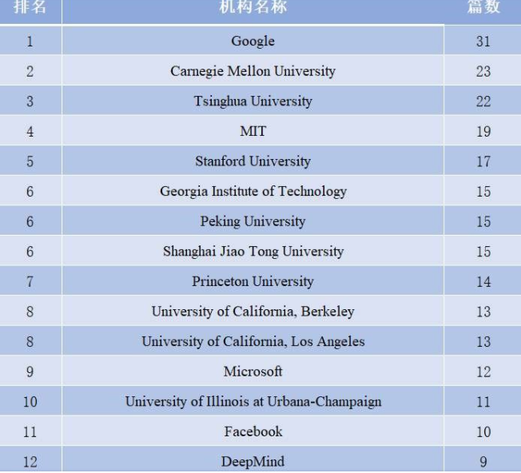

会议简介
ICLR，International Conference on Learning Representations，国际学习表征会议
表征学习对于机器学习及包括视觉、语音、音频及 NLP 领域起着至关重要的作用，目前还缺乏一个场所，能够让学者们交流分享该领域所关心的话题。ICLR 的宗旨正是填补这一鸿沟
2013年由深度学习三巨头之二的Yoshua Bengio 和 Yann LeCun 牵头创办，虽然举办年限较短，但已经被学术研究者们广泛认可，被认为是深度学习的顶级会议

Slide 6
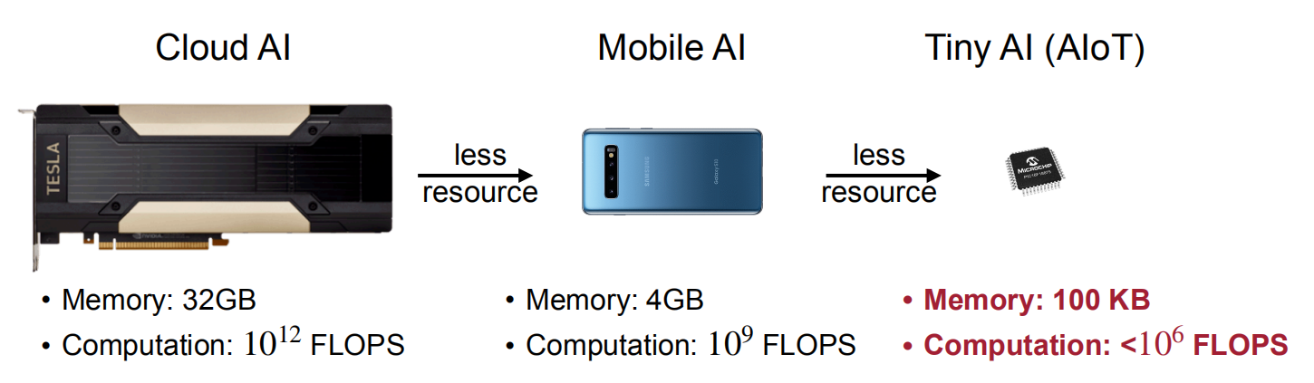
论文动机
Efficient Inference on Diverse Hardware Platforms
Different hardware platforms have different resource constraints. We need to customize our models for each platform to achieve the best accuracy-efficiency trade-off, especially on resource-constrained edge devices.
Notes:
直接在所有硬件平台上使用同一个神经网络，这会导致大量性能和效率上的损失，因为同样的神经网络并不能适配所有场景。如果针对每个硬件平台和效率约束都重头设计并训练一个新的神经网络，这会导致大量的计算资源的消耗，因为这种方式计算资源的需求是随着部署场景数线性增长的。这同样也会导致严重的环境问题，因为大量的计算资源消耗直接可以转化为大量的二氧化碳排放。因此需要这样的通用的 OFA 网络，既可以针对不同硬件平台进行适配而不损失性能和效率，同时不需要额外的计算资源来从头训练一个新的神经网络。

Slide 7
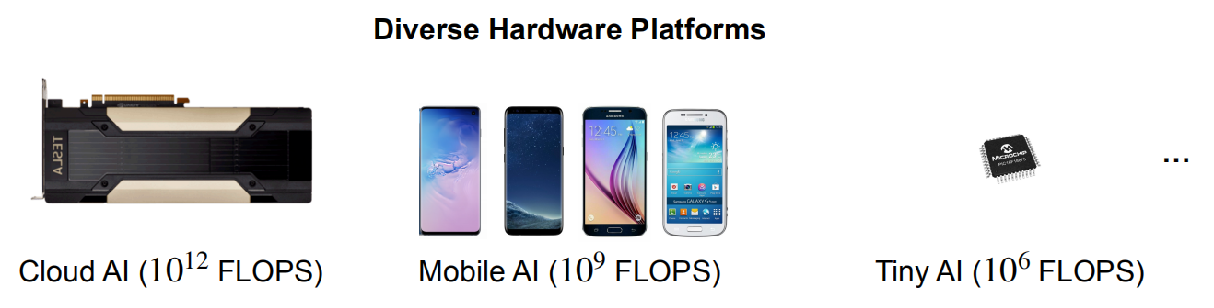
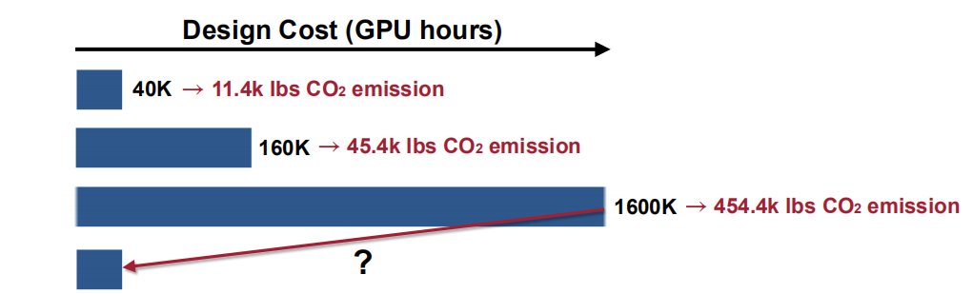
论文动机
Efficient Inference on Diverse Hardware Platforms
Notes:
与采用搜索算法查找子网的大多数AutoML方法不同，研究人员从OFA网络中随机抽取子网的子集来构建其准确性和延迟表。这使他们能够在给定特定硬件平台的情况下直接查询表以找到相应的子网。查询表的成本可以忽略不计，从而避免了其他方法中总成本的线性增长

Slide 8
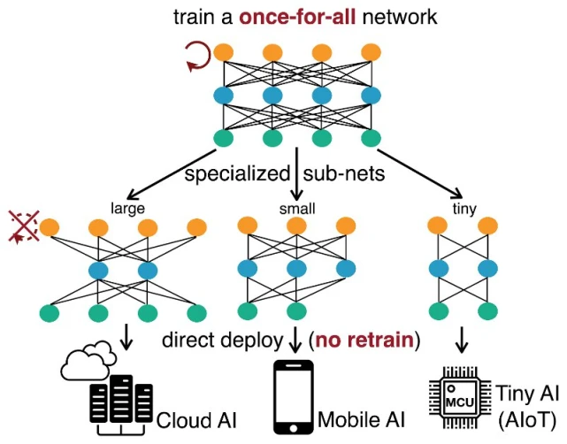
主要方法
One-for-All Network: Decouple Model Training and Architecture Design
Notes:
不同的硬件平台有不同的特性和硬件资源。在同一个平台上，我们也会有不同的效率限制。为了提高硬件平台上的推理效率，我们需要改变神经网路的结构（例如深度，宽度，卷积核大小，输入分辨率等）来适配具体的硬件。一个通用的 OFA 网络支持在大量不同的结构设置下通过截取 OFA 网络的不同部分来进行高效推理。对于计算资源丰富的云端设备，我们可以截取一个大的子网。而对于计算资源短缺的边缘设备，我们则可以截取一个较小的子网。

Slide 9
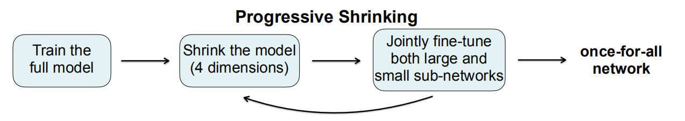
主要方法
Progressive shrinking for trainning OFA Networks
More than 10¹⁹ different sub-networks in a single once-for-all network, covering 4 different dimensions: resolution, kernel size, depth, width
Directly optimizing the once-for-all network from scratch is much more challenging than training a normal neural network given so many sub-networks to support
Small sub-networks are nested in large sub-networks
Cast the training process of the once-for-all network as a progressive shrinking and joint fine-tuning process
Notes:
一个 OFA 网络需要同时支持大量不同的子网（>10^19）。它们之间会相互干扰，这使得 OFA 网络比一般结构确定的神经网络要更难优化。为了解决这个问题，提出 progressive shrinking 算法来训练 OFA 网络。各种不同的子网是一层层嵌套在最大的神经网络中的。因此将 OFA 网络的训练过程建模为一个逐渐缩小与微调的过程。首先会训练最大的网络。然后逐渐缩小网络的各个维度（输入分辨率，卷积核大小，深度，宽度）来支持较小的子网。同时会微调网络的权重使其在支持较小的子网的同时不会丢失在较大子网下推理的能力。某种程度上，progressive shrinking 也可以看作是一种广义上的剪枝方法。

Slide 10
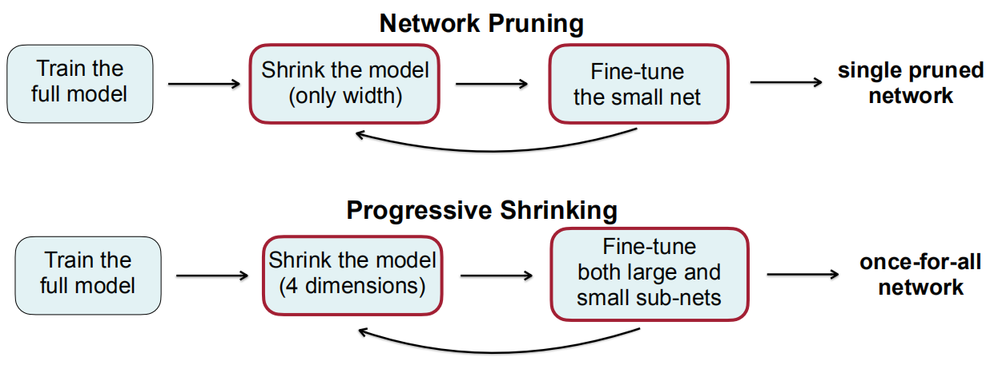
主要方法
Connection to Network Pruning
Progressive shrinking can be viewed as a generalized network pruning with much higher flexibility across 4 dimensions

Slide 11
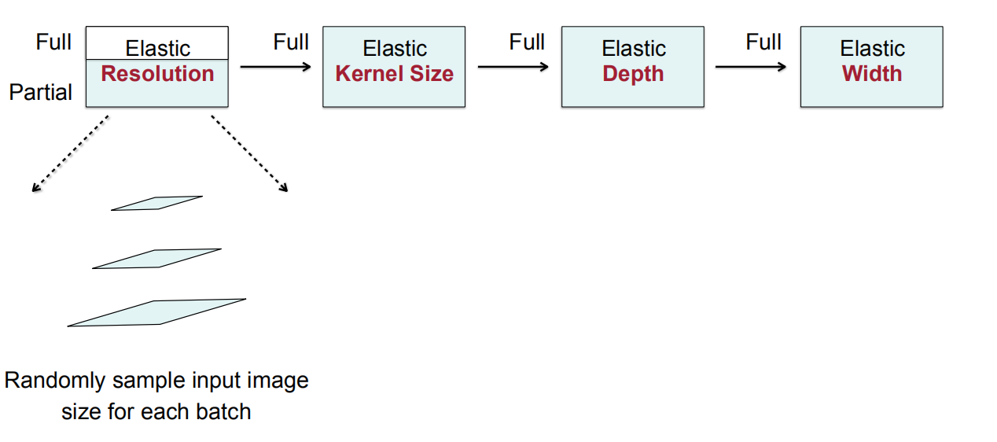
Progressive Shrinking

Slide 12
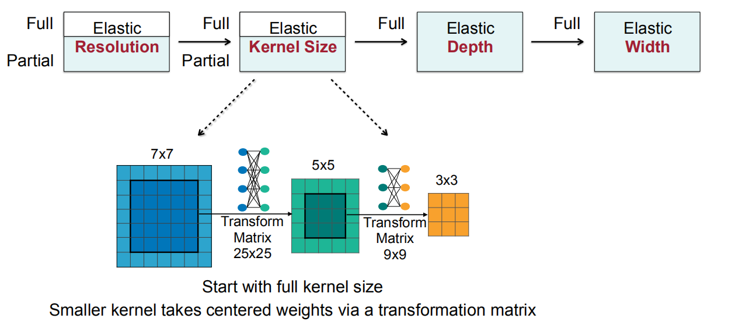
Progressive Shrinking

Slide 13
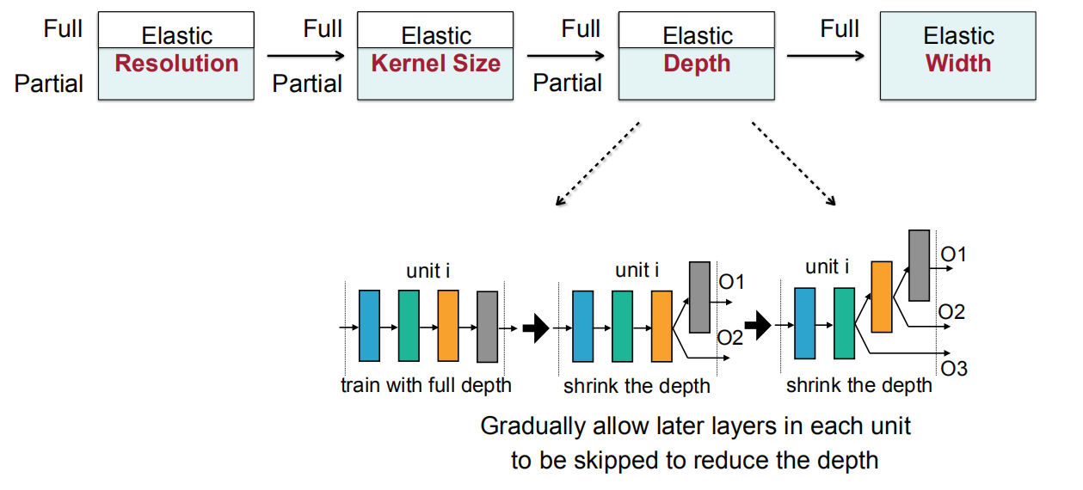
Progressive Shrinking

Slide 14
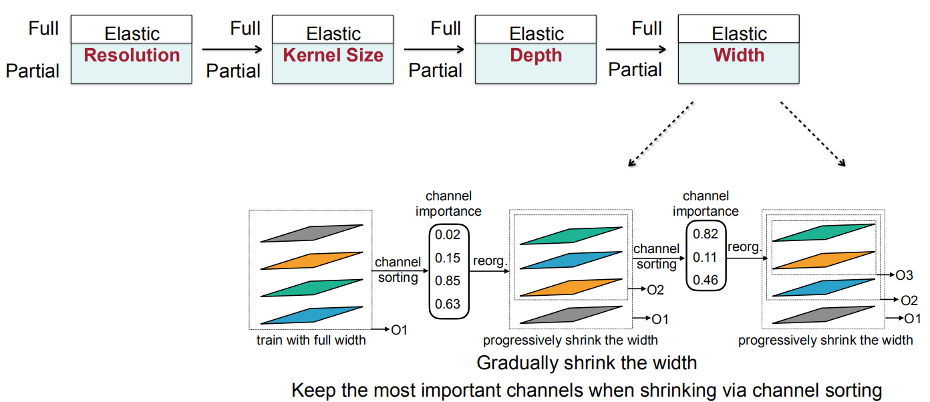
Progressive Shrinking

Slide 15
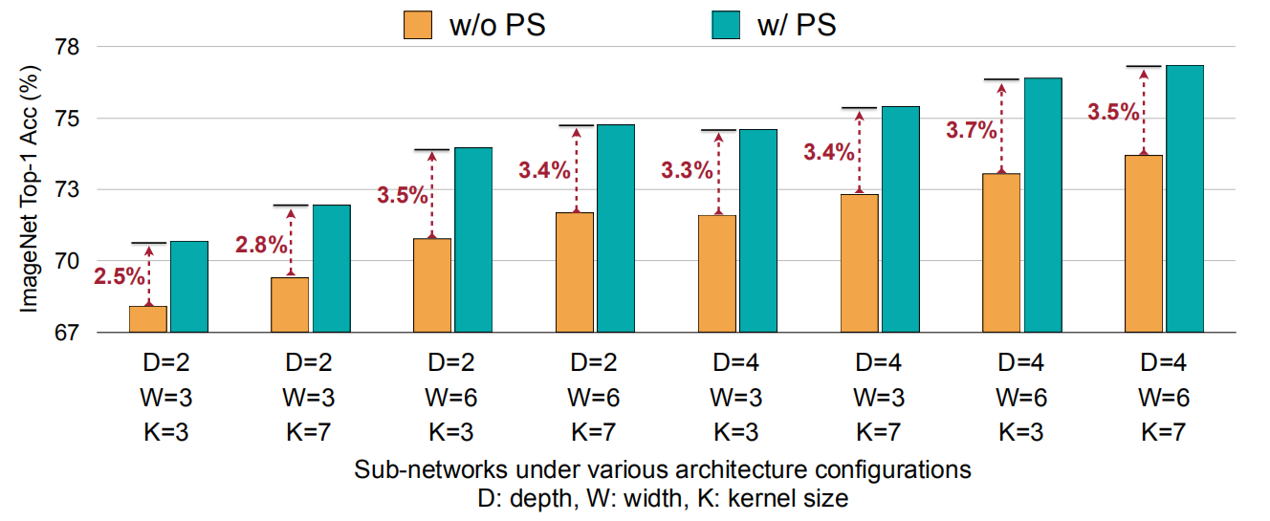
实验结果
Performances of Sub-networks on ImageNet
Progressive shrinking consistently improves accuracy of sub-networks on ImageNet.

Slide 16
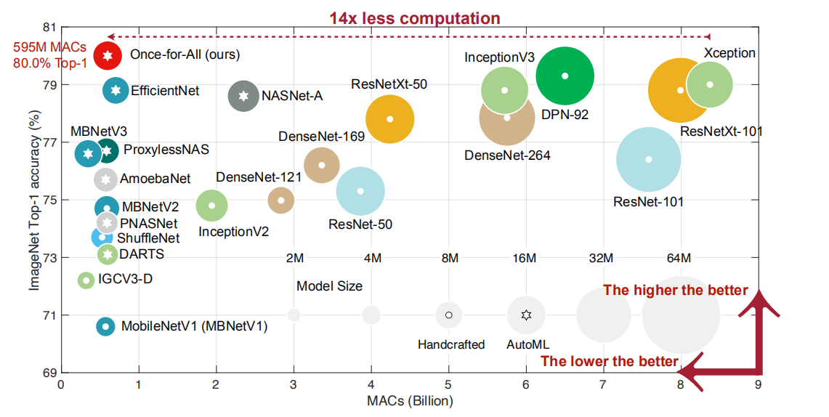
实验结果
OFA: 80% Top-1 Accuracy on ImageNet
OFA sets a new state-of-the-art 80% ImageNet top-1 accuracy under the mobile setting (< 600M MACs).

Slide 17
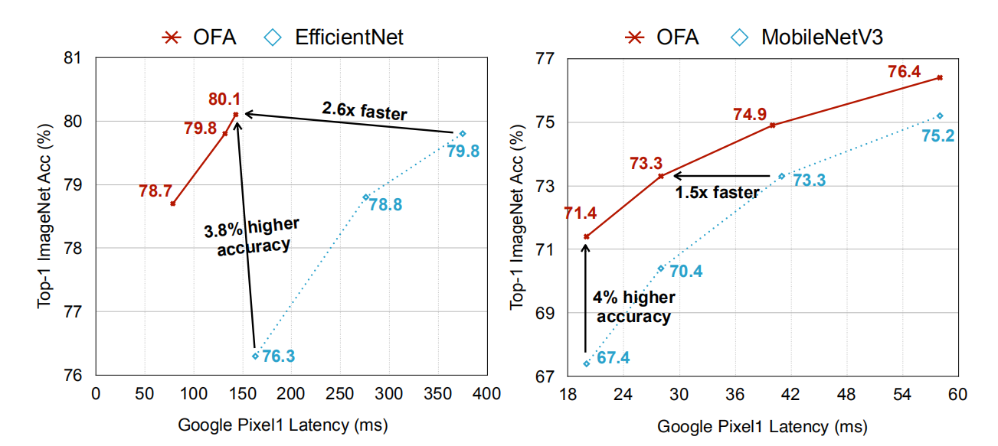
实验结果
Comparison with EfficientNet and MobileNetV3
Once-for-all is 2.6x faster than EfficientNet and 1.5x faster than MobileNetV3 on Google Pixel1 without loss of accuracy

Slide 18
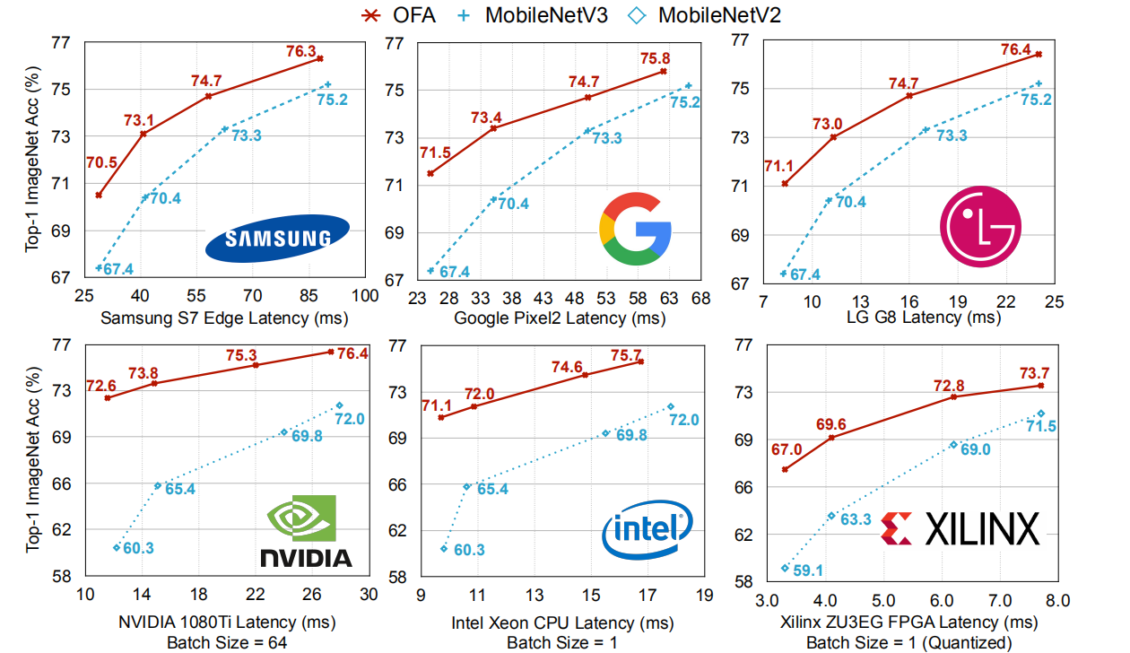
实验结果
OFA for Fast Specialization on Diverse Hardware Platforms

Slide 19
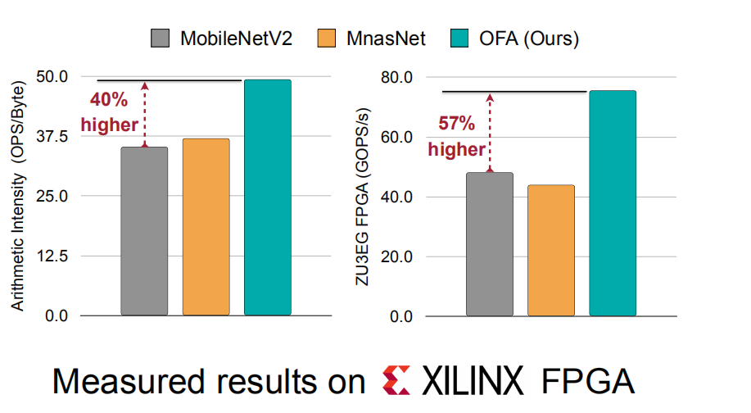
实验结果
OFA for FPGA Accelerators
Non-specialized neural networks do not fully utilize the hardware resource. There is a large room for improvement via neural network specialization

Slide 20
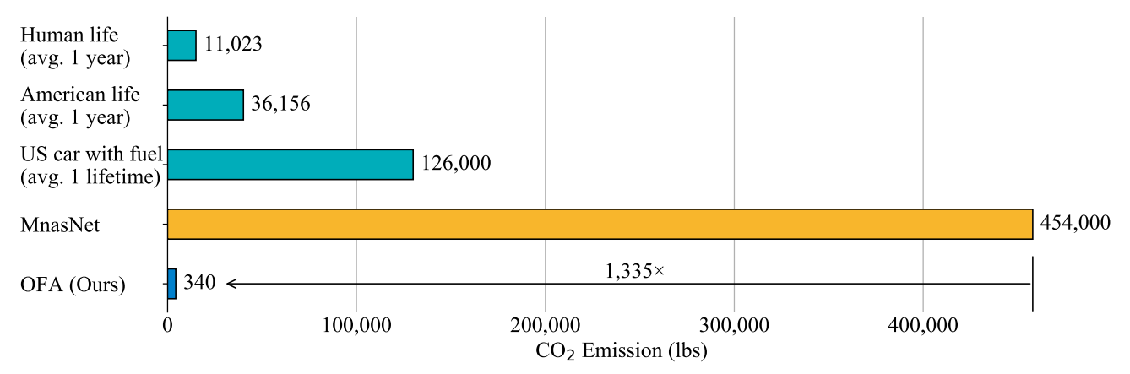
实验结果
OFA Saves Orders of Magnitude Design Cost
Geen AI is important. The computation cost of OFA stays constant with hardware platforms, reducing the carbon footprint by 1,335x compared to MnasNet under 40 platforms

Slide 21
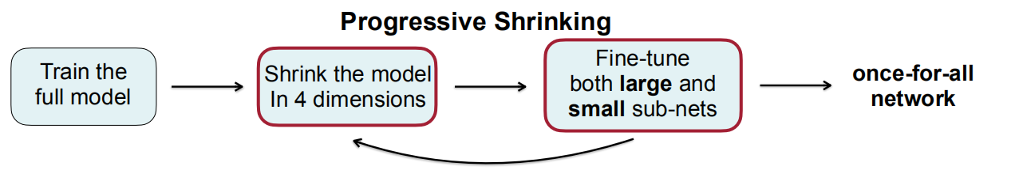
总结
introduce once-for-all network for efficient inference on diverse hardware platforms
present an effective progressive shrinking approach for training once-for-all networks
Once-for-all network surpasses MobileNetV3 and EfficientNet by a large margin under all scenarios, setting a new state-of-the-art 80% ImageNet Top1-accuracy under the mobile setting (< 600M MACs).
First place in the 3rd Low-Power Computer Vision Challenge, DSP track @ICCV’19
First place in the 4th Low-Power Computer Vision Challenge @NeurIPS’19
Released 50 different pre-trained OFA models on diverse hardware platforms (CPU/GPU/FPGA/DSP)

Slide 22
Thinkings
1.OFA是一个偏系统性的工作，整合了现有方法，思想跟One shot NAS类似，使用大量的GPU资源首先训练一个超网络，再使用渐进收缩算法逐步训练子网络，之后根据不同的硬件要求从训练好的超网络中选择子网络进行应用（用训练得到的accuracy predictor and latency predictor搜索子网络）
2.跟One shot NAS方法差异：One Shot NAS首先训练一个supernet，然后对于每个sub-nets不训练，直接评估，选出最好的之后再fine tune，而本文对于每个sub-nets从不同的维度逐步剪枝和finetune，得到最后的网络。缺点就是训练超网络的开销会很大（ training the OFA Network on ImageNet taking around 1,200 GPU hours on V100 GPUs）
3.是否可以在模型压缩中借鉴progressive shrinking的方法， 除了width之外，对其他维度也进行探索，在压缩限制下选择性能最优的
Notes:
训练supernet和architecture search的过程解耦
四个维度采样了一些sub-network，训练出一个accuracy predictor和latency predictor，用这2个神器得到符合要求的sub-network
按照这个方法从1个supernet得到无数个sub-nets，再按硬件的要求选择合适的sub-nets，就实现了题目中要求的一次训练，到处部署。
在处理多个部署方案时，OFA比NAS快几个数量级（N）。N=40时，OFA所需GPU小时数比ProxylessNAS少14倍，GPU小时数比FBNet少16倍，GPU小时数比MnasNet少1,142倍。部署方案越多，对NAS的节省就越多

